Slide 1

Professor Terry Power
Bus. & Ec. - Open Learning Division
Thompson Rivers University
Stepping through AI's 'looking glass':
The day Academia as we know it disappears.
10 New Business Models

Slide 2
Introduction

Slide 3

Background
“The time has come," the Walrus said, “To talk of many things: Of shoes—and ships—and sealing-wax— Of cabbages—and kings— And why the sea is boiling hot— And whether pigs have wings.”
“But wait a bit," the Oysters cried, “Before we have our chat; For some of us are out of breath, And all of us are fat!”
                .. Lewis Carroll.
Notes:
Today new mental models.. Bias,, all things are possible
Want to stay fat.. Get out in front of the parade. Quick an the dead
(HYPERCONNECTED WORLD –Link Office of the Director of National Intelligence - Global TrendsOffice of the Director of National Intelligence - Global Trends

Slide 4
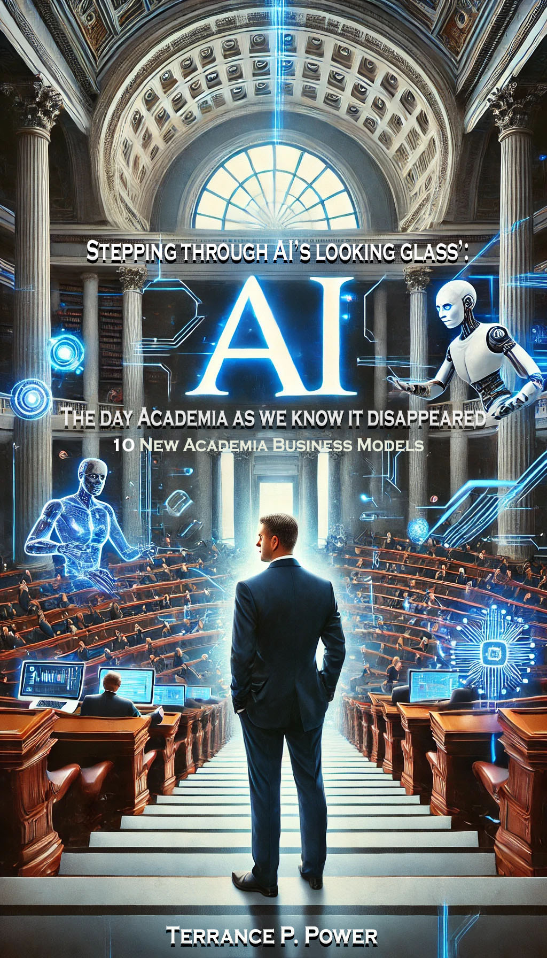
Index
Preface
About the Author
Acknowledgements
Preface
Chapter 1 Introduction
Chapter 2 Background
Chapter 3 Singularity
Chapter 4 7 Steps to Singularity
Chapter 5 10 New Business Models
Chapter 6 New Mental Model -#10 Browser
Closing Remarks
Appendix A

Slide 5
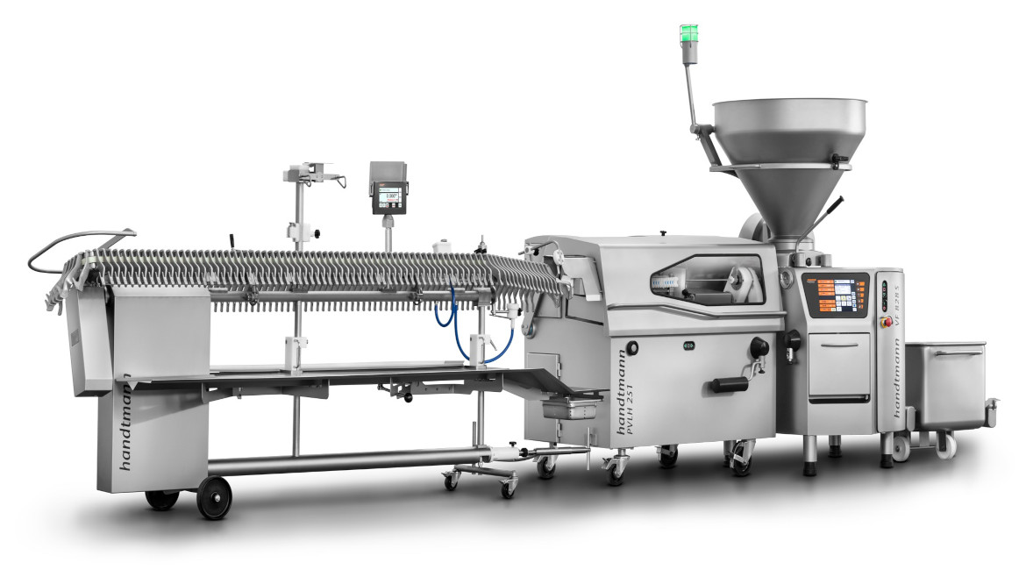
Wrong Sausages
Trajectories.. Growing apart..
Co Chaired National Conferences - Finance (CMC),
Calgary Oil and Gas Association,
Nursing (UV)
Comment --- VP{ Bank of NS… (Wrong sausages)

Slide 6
Zero Marginal Cost Society
  I am of the opinion that we are witnessing capitalism being 'reset' to accommodate the realities this brave new world driven in large part by the Internet of things that will result in massive unemployment.
  Only countries that are based on knowledge will survive as will the workers... the masses will have to be taken care of just as the Romans did prior to the Vandals and Visigoths and 472 AD.
  The reality is that middle-class continue to shrink and the standard of living of 80% of Canadians will stagnate and indeed fall; As well Canada's total failure be "hungry" and drive innovation and research and development.. to strip away bureaucracy and impediments.
  If we do nothing.... we will be faced with our own Arab Spring. You cannot have mass unemployment folk particularly between 19 and 25 unemployed with high student loans without 'a dream'. This particular demographic segment is quickly moving towards a tipping point that we must be concerned about...

Slide 7


Classrooms have not changed..

Slide 8
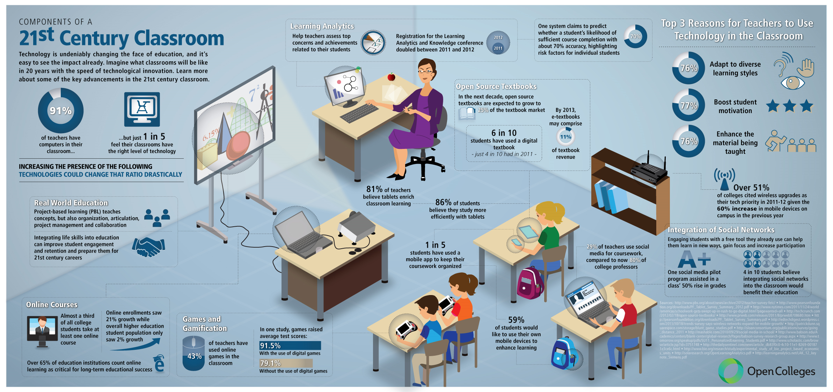
Notes:
Speaking Points: Technology play a key role in classroom innovation. Collaboration is the future of education and its ability to optimise learning. Students learning in a collaborative, team setting are believed to think at a higher level, take away more information and retain that information for longer than those who work alone. Changing dynamics of the classroom have revolutionised the arts of teaching and learning. Collaborative workers are more inclined to learn through “discussion, clarification of ideas, and evaluation of other’s ideas”.
Ref: https://blogs.technet.microsoft.com/nzedu/2013/01/06/collaboration-and-the-role-of-technology-in-the-21st-century-classroom/

Slide 9

DIGITIZED CLASSROOMS
Rather than considering IT a standalone tool or skill, digitization tends to disperse throughout every facet of the classroom.
Tablet Computing
Digital Boards
Screens with different uses
Dashboards
Students are free to collaborate with peers globally
Notes:
Speaking Points: Classrooms have seen increasing digitization over the last two decades. No longer is technology relegated to a 'computer lab' but is fully integrated into the classroom and curriculum. As a result, the tech skills of both students and teachers has increased. The connection of the classroom tech to the IoE has globalized the classroom, equipping each class with limitless knowledge.
However, there are challenges. In a Learning Partnership study (funded by Samsung, 2015) school leaders, teachers and parents stated a lack of effective training and support for educators, lack of educator confidence, comfort and competence in using technology; IT and infrastructure complications; and lack of allocated time to learn and adopt new methods.
10 Emerging Educational Technologies & How They Are Being Used Across the Globe
www.innovationexcellence.com/blog/2013/07/29/10-emerging-educational-technologies-how-they-are-being-used-across-the-globe/
10 EdTech Tools for Encouraging Classroom Collaboration
http://www.gettingsmart.com/2017/01/10-edtech-tools-classroom-collaboration/
Samsung. (September 2015). Emerging Technologies, Evolving Education. The Learning Partnership. Retrieved from
http://pages.samsung.com/ca/solvefortomorrow/French/pdfs/evolving_education.pdf

Slide 10
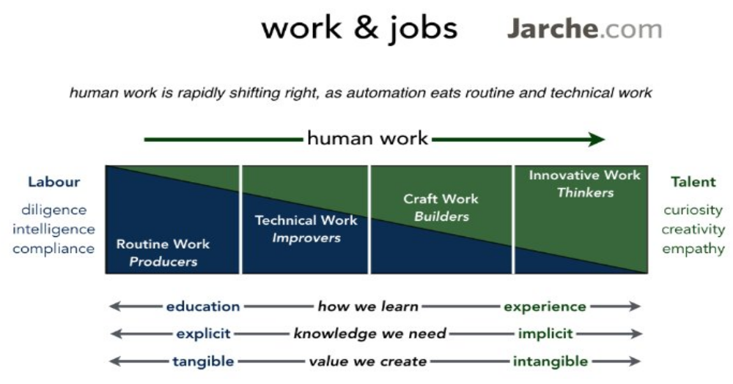

Slide 11

Where the jobs are
Coding
Knowledge management
Analytics
Cyber security tech..
  Popping up 17 -24 weeks
Software engineering
Economics
Technicians
Co-bots
Singularity

Slide 12

Know me and market to me
Click here

Slide 13
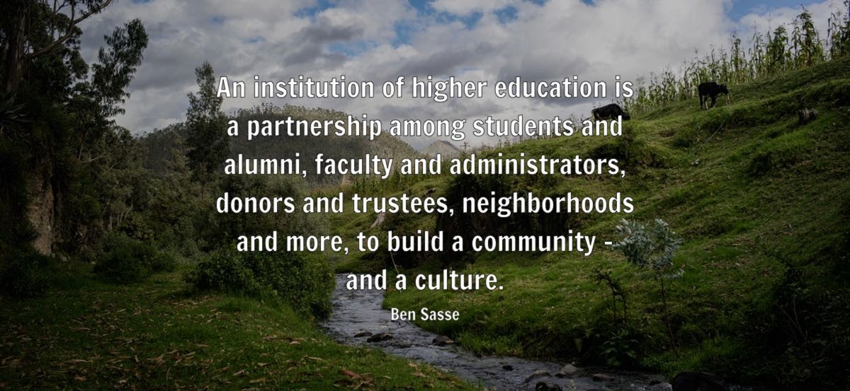
So what?
In 2013, Udacity predicted that in 50 years, only 10 educational institutions in the world would be delivering any type of higher education.

Slide 14
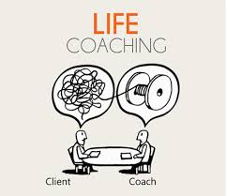

Job Opportunities ….
Individual consultants are creating businesses in coaching, providing business start-up advice, and teaching others how they too can create their own you-tube channel, blog and posting system to sell their ideas over the internet.

Slide 15

Singularity

Slide 16

AI’s 7 Steps- (Domains)
Step Seven: The AI
Singularity
Step Six: Artificial Super
Intelligence (ASI)
Step Five: Artificial General Intelligence
(AGI)
Step Four: Thinking and Reasoning AI Systems
Step Three: Domain-Specific Mastery Systems
Step Two: Context Awareness and Retention Systems
Step One: Rule-Based AI Systems
Notes:
Stage One: Rule-Based AI Systems
Rule-based AI systems, also known as one-task systems, represent the earliest stage of artificial intelligence. These systems operate based on a predefined set of rules or an algorithm given to them by programmers. They are excellent for tasks with clear rules, such as diagnosing a mechanical problem or processing tax forms. However, their intelligence is firmly limited, and they lack the ability to learn or understand context.
Stage Two: Context Awareness and Retention Systems
Context awareness and retention systems represent a significant evolution in artificial intelligence. These AI systems are capable of understanding and retaining context, meaning they can remember previous interactions and use that knowledge to inform future responses. A great example of this is your smartphone assistant like Siri or Google Assistant. They not only process and execute commands but also learn from your past interactions.
Stage Three: Domain-Specific Mastery Systems
Domain-specific mastery AI can be found in a variety of specialized applications. These systems are not generalists; they’re experts fine-tuned to excel in a specific area. A perfect example of this is IBM’s Watson, which was designed to excel at answering questions on the quiz show Jeopardy. Another instance is Google’s Deep Mind AlphaGo, which was trained specifically to master the complex board game Go.
Stage Four: Thinking and Reasoning AI Systems
Thinking and reasoning AI systems attempt to simulate the human thought process. They can understand complex concepts, solve unfamiliar problems, and even generate creative ideas. This is made possible by techniques like machine learning and deep learning, which allow the AI to learn from experience and improve its performance over time.
Stage Five: Artificial General Intelligence (AGI)
Artificial General Intelligence (AGI) represents a world where AI can equal human intelligence in all aspects. An AGI system would be capable of understanding, learning, adapting, and implementing knowledge across a wide range of tasks. It would possess self-awareness, consciousness, and the ability to understand and navigate the world just as a human would.
Stage Six: Artificial Super Intelligence (ASI)
Artificial Super Intelligence (ASI) is a level of artificial intelligence where things get really complicated. An ASI system would possess cognitive skills far surpassing our own. It could potentially solve problems that humans can’t, coming up with solutions to complex global issues like climate change or disease. However, the advent of ASI also brings with it a host of ethical and safety concerns.
Stage Seven: The AI Singularity
The AI Singularity represents a hypothetical future point in time when technological growth becomes uncontrollable and irreversible, leading to unforeseeable changes to human civilization. This is primarily associated with the advent of artificial superintelligence. The concept of the singularity is highly speculative and controversial.

Slide 17
Ten New Academic Business Models
Notes:
New mental models

Slide 18
# 1. AI-Powered Personalized Learning-as-a-Service
With AI-driven education, universities could offer adaptive learning experiences that personalize course content based on students’ progress, learning styles, and career goals. AI tutors, holographic professors, and virtual reality (VR) classrooms could replace one-size-fits-all lectures.
Revenue Streams:
• Personalized learning subscriptions (SaaS model)
• Pay-per-use AI tutoring services
• Corporate-sponsored learning paths for employees
For example WCB Certification.

Slide 19
# 2. Block chain-Based Micro-Credentials & Skill Verification
Instead of traditional degrees, students could earn block chain-verified micro-credentials for specific skills. Employers would recognize these credentials, making education modular and lifelong. Universities would shift from degree providers to skill certifiers.
Revenue Streams:
• Fees for credential issuance and verification
• Corporate partnerships for skill-based hiring
• AI-driven career placement services

Slide 20
# 3 AI-Driven Research Commercialization
Universities could monetize AI-driven research by patenting AI-generated discoveries, licensing technology to industries, and forming AI-powered research-as-a-service platforms.
Revenue Streams:
• AI-powered R&D services for companies
• Licensing AI-generated patents and discoveries
• Crowdsourced AI research competitions

Slide 21
# 4 Virtual & Metaverse-Based Universities
With VR and metaverse integration, universities could go fully digital, offering immersive learning experiences without physical campuses. Students would attend lectures in virtual classrooms, conduct experiments in simulated labs, and engage in global networking.
Revenue Streams:
• Virtual university tuition (lower-cost, global access)
• Digital real estate for universities in the metaverse
• VR-based corporate training partnerships

Slide 22
# 5. AI-Education Partnerships with Corporations
Instead of students paying tuition upfront, universities could partner with corporations to offer “Learn Now, Pay Later” models, where education is tied directly to industry needs. Companies would fund education in exchange for future employment commitments.
Revenue Streams:
• Direct corporate funding for specialized programs
• Income-sharing agreements where students repay education costs post-employment
• AI-driven corporate reskilling programs

Slide 23
# 6. Subscription-Based Lifelong Learning Models
Subscription-Based Lifelong Learning Models
Given the fast-paced evolution of technology, learning will become continuous. Universities could offer lifetime memberships for ongoing education, where professionals subscribe to always stay updated with industry changes.
Revenue Streams:
• Monthly or yearly subscriptions for ongoing education
• AI-driven course recommendations for career advancement
• Exclusive access to industry webinars, mentorship, and AI-powered career guidance
⸻

Slide 24



# 7. AI-Human Hybrid Teaching Services
Rather than fully replacing human educators, universities could blend AI tutors with human mentors to offer premium educational services. AI handles content delivery and grading, while human instructors focus on critical thinking, creativity, and mentorship.
Revenue Streams:
• Premium AI-human hybrid tutoring models
• Corporate leadership development using AI-personalized training
• AI-driven soft-skills training (emotional intelligence, ethics, decision-making)

Slide 25
# 8. Decentralized Autonomous Universities (DAUs) – Web3 & DAO-Based Education
. Decentralized Autonomous Universities (DAUs) – Web3 & DAO-Based Education
In a decentralized education system, universities could operate as DAOs (Decentralized Autonomous Organizations) where governance, funding, and accreditation are managed by smart contracts and community voting.
Revenue Streams:
• Tokenized tuition and governance models
• Crowdfunded educational projects
• NFT-based ownership of educational content

Slide 26
# 9. AI-Generated Knowledge-On-Demand Services
AI-Generated Knowledge-On-Demand Services
With AI surpassing human intelligence, students and professionals may no longer need traditional learning but rather instant access to knowledge. Universities could offer on-demand AI-powered research assistants for complex problem-solving.
Revenue Streams:
• AI-powered consultancy services for businesses and researchers
• Subscription access to advanced AI knowledge engines
• Pay-per-query AI research generation
⸻

Slide 27
# 10 Universities as “Browser” Model
1. Universities as Education Marketplaces (Browser Model)
Instead of creating all content in-house, universities could become platforms that curate and certify MOOCs, online courses, and AI-generated content from various institutions and experts worldwide. Students would have access to a “pick-and-choose” curriculum, earning micro-credentials and degrees from multiple providers.
Revenue Streams:
Subscription-based access to our portfolio of approved courses
Commission from partner institutions for student enrollments
Value-added services like career counseling, mentorship, and AI-driven learning recommendations
Course Packs
Admission Exam. certifying

Slide 28
Part 2 Cont.. New Academic Business Models.
# 1- “The Browser”
# 1… Browser
9 others on my Blog site subscribe..
Book on this topic
Educational Articles
Terry Power's Strategic Thinking Concepts | Place to learn business strategies and strategic thinking concepts.

Slide 29

Don Huesman, Wharton Fellow
Managing Director Wharton Innovation Group,
Wharton School of the University of Pennsylvania
FROM… Bloomberg Businessweek
http://www.businessweek.com/news/2013-09-13/wharton-offers-free-online-courses-copying-first-year-mba-study
“Wharton Offers Free Online Courses Copying First-Year MBA Study
By Louis Lavelle September 13, 2013
For a $49 fee, students can get a verified electronic certificate showing they’ve completed course requirements.

Slide 30
The WHAT?
2011: a new trend for learning began called MOOCs
MOOCs use adaptive technology to deliver world renowned teaching to anyone with internet access
What MOOCs are able to offer and who they are designed to help continues to evolve

Slide 31
contribution to zero marginal cost society
Two primary ways that MOOCs contribute:
  Crowd sourcing
  Access to everyone

Slide 32
The why?
Affordable high quality education
MOOCs let learners browse their potential interests
Can be hybridized with traditional lectures to give learners more options
Self-directed learning in manageable portions

Slide 33
Self learning: the future of MOOCs
Keys to self learning:
  Provide encouragement
  Remove the threat
  Make it fun
If these key features can be integrated, MOOCs will become a positive disruptive force in education.

Slide 34
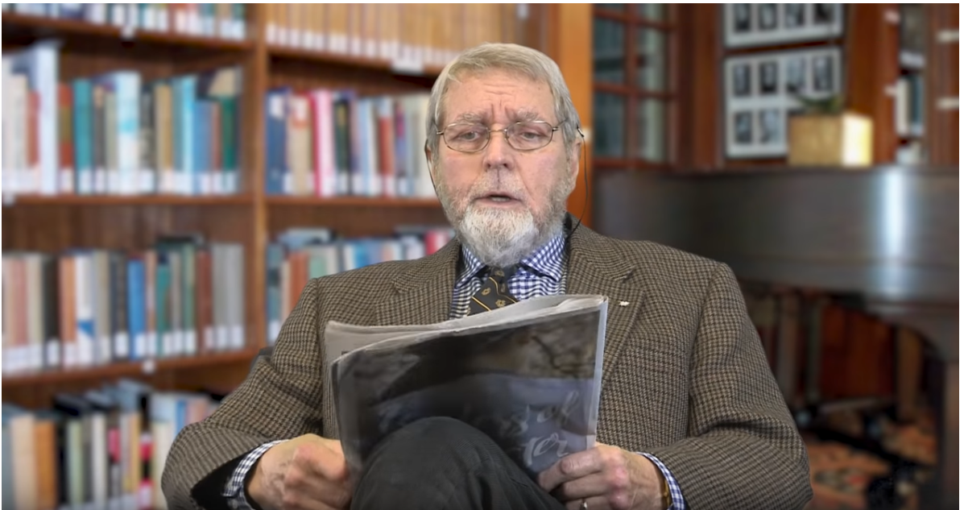
OPENING OF INFORMATION
  Online School Communities
  Advanced High quality learning
  Tailormade Curriculum
  Cherry Pick World's best Courses
  Example:edX
  Education App stores
MOOC learning
  Dynamic Specializations
  Global Student Base
  Increased Volume – Freely Open
  Lower Cost
  Profit through Textbooks
What is a MOOC ?- VIDEO
Notes:
Speaking Notes:
Education is continuously becoming easier to access from anywhere and caters delivery methods for differing lifestyles. One trend that we are currently witnessing and anticipated to be more prominent in the years to come is the Idea of Opening of information, more specifically the Dissemination of information outside the physical silos of schools and classrooms, offering feedback and assessment to students anywhere.
Online School Communities or e-learning courses are becoming more common and preferred over traditional delivery methods. Similar to the Royal Roads EMBA program, many schools offer e-learning options or a blended ( online / residency) approach . Video Lesson have been designed for effective delivery and value add material . The benefit for students is it provide flexibility and ability to maintain careers growth and salary.
Another trend in education is Tailor made learning / Inter School teaching platforms - Courses are becoming more freely available with both cost and access. A great example of high quality open source, MOOC learning that provides the ability to cherry pick your curriculum is EDX.org .
Classes are now being delivered on a mass scale with delivery coined as MOOC – Mass open online courses – that connect people around the globe and provide dynamic specializations on a mass scale. They often emphasize open access features such as licensing, information and structure. Many are non-profit organizations and profit can come through the purchase of text books. The idea is anyone can participate from anywhere bringing attention to knowledge distribution through connectivity and how shifting how we learn ( EDX) .
ADDITIONAL EXAMPLES / INFO:
EDX was founded by Harvard University and MIT . Its an online learning platform and MOOC provider that allows you to learn anytime from anywhere. They have 130 global partners with courses from Harvard, Berkeley, UBC , Hong Kong just to name a few.
Often Education can be limited access. For instance many schools require GPA , or minimal standards for acceptance. Similar to MOOCs courses are more and more open to public, businesses and students. . Education App Stores – Mobile devices – are open source courses that you can take on an app from your mobile phone. There are apps now that you can sign up for courses and complete 90-100 percent of the course. It is catered to on the go individuals .
REFERENCES:
https://library.educause.edu/topics/teaching-and-learning/massive-open-online-course-mooc
https://www.edx.org/about-us
https://www.usnews.com/higher-education/online-education/articles/2017-02-16/ask-4-questions-about-accessing-online-courses-on-mobile-devices
https://www.youtube.com/watch?v=eW3gMGqcZQc
https://open.edx.org/blog/future-education-open-source

Slide 35
A Few --Closing Remarks
As AI and singularity reshape knowledge creation and dissemination, universities will need to transition from degree-granting institutions to lifelong learning platforms, AI-driven knowledge hubs, and skill-certification networks. The traditional tuition model will fragment, giving way to subscription-based learning, corporate-funded education, and decentralized credentialing.
Which of these models do you think academia should embrace first?

Slide 36
Closing remarks
.
visit blog subscrible https://terrypowerstrategy.com/

Slide 37


Slide 38

Notes:
1920 Times Square. How fast changed.. Infrastructure.. New skills // education needed.. ’tipping point’ … faster today…
Fast today

Slide 39
Spare slides

